Slide 1
PROJECT IBM COURSERA ADVANCED DATA SCIENCE CAPSTONE
Artist Recommender System
Amit Pandit

Slide 2
STATUS SUMMARY
Data Set [Use Case]
Exploration of Data
Data Cleansning,Aggregation
Model Definition ,Model Training
Model Evaluation

Slide 3
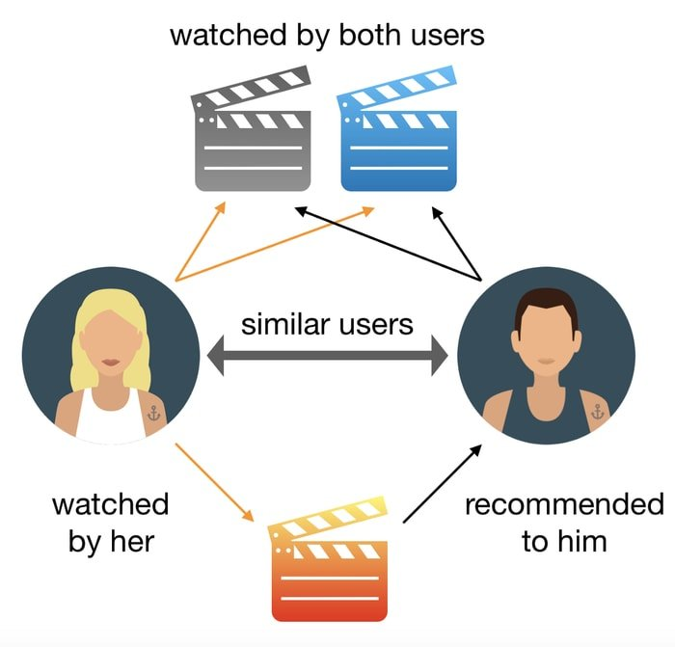
USE CASE

Slide 4


PROGRESS
In this project, I will use a data set published by Audioscrobbler - a music recommendation system for last.fm. Audioscrobbler is also one of the first internet streaming radio sites, founded in 2002. It provided an open API for “scrobbling”, or recording listeners’ plays of artists’ songs. last.fm used this information to build a powerful music recommender engine.
DataSets
user_artist_data.txt
artist_data.txt
artist_alias.txt
140,000 unique users
1.6 million users
Source:http://www.iro.umontreal.ca/~lisa/datasets/profiledata_06-May-2005.tar.gz

Slide 5
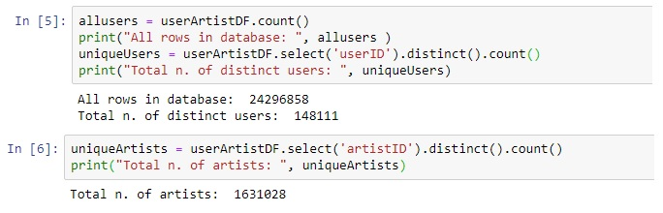
Data Exploration
In this module we find the all number of artist and how many distinct users are exit in the datasets.

Slide 6
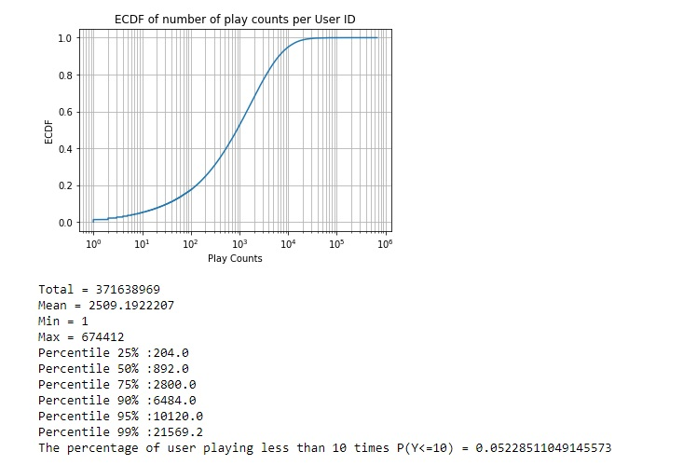
Data Explortion

Slide 7
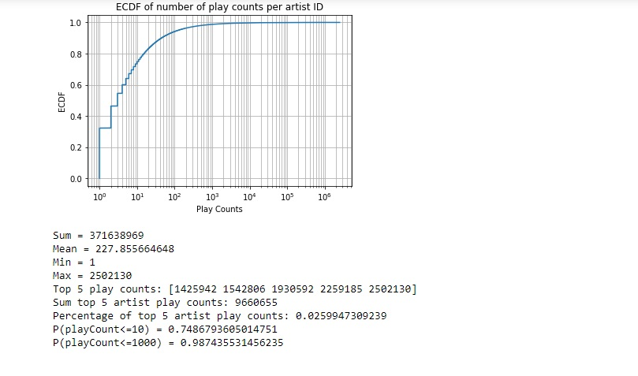
Data Exploartion

Slide 8
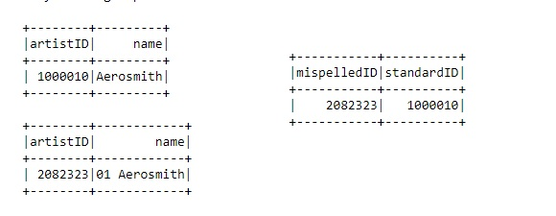
Data Cleansing

Slide 9
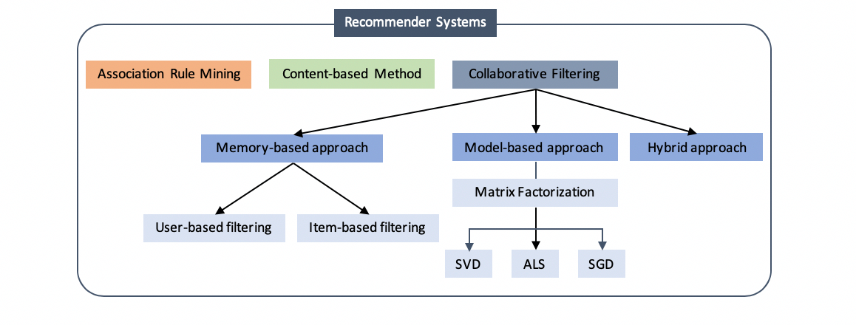
Model Definition

Slide 10
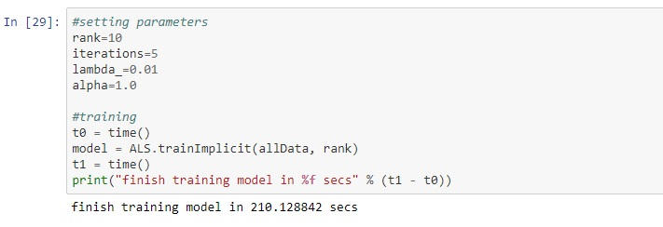
Model Training

Slide 11
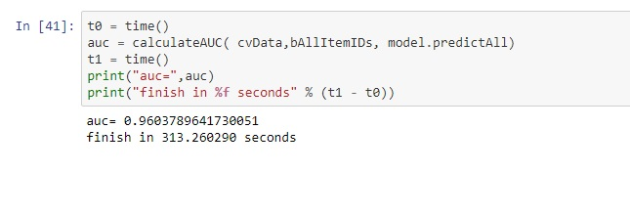
Model Evaluation
With the help of ALS Algorithm I trained the model with 96% accuracy.
ALS is the one of types of model Factorization techinque.

Slide 12
Conclusion
I introduce the an algorithm to do matrix factorization(ALS) and the way of making recommendations.
This model is based on who has more number of play counts.
The accuracy of model is that 96%.

